Slide 1

Artificial Neural Networks I

Slide 2
INTRODUCTION
As we have noted, a glimpse into the natural world reveals that even a small child is able to do numerous tasks at once.
The example of a child walking, probably the first time that child sees an obstacle, he/she may not know what to do. But afterward, whenever he/she meets obstacles, she simply takes another route.
It is natural for people to both appreciate the observations and learn from them. An intensive study by people coming from multidisciplinary fields marked the evolution of what we call the artificial neural network (ANN).

Slide 3
Factors that has resulted in a high industrial use of ANNs
Their ability to solve very complex problems with great ease.
ANNs have a great ability to learn large volumes of data, which enables them to give accurate results whenever the data reappear in the problem. This ability to learn is mainly due to the inherent property of ANNs being able to imitate almost any function.
Their ability to give the correct answers to unknown inputs. In most cases, they are able to find the correct answer to unknown inputs with sufficient accuracies whenever that are presented to the system.
These networks have become very handy tools for industrial implementations. In fact, ANNs are being used in almost every industry to solve real-life problems.

Slide 4
ANN’s- How They Operates
ANNs represent a highly connected network of neurons, or the basic processing units,
They operate in a highly parallel manner.
Each neuron does some amount of information processing.
It derives inputs from some other neuron and in return gives its output to other neurons for further processing.
This layer-by-layer processing of the information results in great computational capability.
As a result of this parallel processing, ANNs are able to achieve great results when applied to real-life problems.

Slide 5
Historical Note
The magnificent computing capabilities of the human brain have always been a source of inspiration for people in multiple disciplines. For centuries, people have tried to devise methods to study and imitate the brain.
Connection
Strengths
Neurons
Connections
w
w
Input 1
Output 1
Input 2
Output 2
Input 3
w
w
Input Layer
Hidden Layer
Output Layer
Figure 2.1a The architecture of the artificial neural network.

Slide 6
Historical Note Continues
Warren McCulloch and mathematical prodigy Walter Pitts gave McCulloch-Pitts theory of formal neural networks (Haykin, 1994).
In 1949, Donald Hebb further extended the work in this field, when he described how neural pathways are strengthened each time they are used
In 1954, Marvin Minsky presented his thesis “Theory of Neural-Analog Reinforcement Systems and Its Application to the Brain-Model Problem” and also wrote a paper titled “Steps Toward Artificial Intelligence.”
Later John von Neumann invented the von Neumann machine.
1958, Frank Rosenblatt, a neurobiologist, proposed the perceptron, which is believed to be the first physical ANN.

Slide 7
Historical Note Continues
Between 1959 and 1960, Bernard Wildrow and Marcian Hoff developed the Adaptive Linear Elements (ADALINE) and the Multiple Adaptive Linear Elements (MADELINE) models.
In 1986, Rumelhart, Hinton and Williams proposed the back propagation algorithm.
Inputs
Input Layer
Hidden Layer
Output Layer
Outputs
Figure 2.1b The schematic diagram of the artificial neural network.

Slide 8
The Biological Neuron
ANNs are an inspiration from the biological neuron.
We introduce you to a model that has millions of neurons, all talking to each other at unimaginable speeds. This model is the human brain.
The entire human brain consists of small interconnected processing units called neurons and are connected to each other by nerve fibers
The interneuron information communication makes it possible for multilevel hierarchical information processing, which gives the brain all its problem-solving power.

Slide 9
The Biological Neuron (continued)
Each neuron is provided with many inputs, each of which comes from other neurons.
Each neuron takes a weighted average of the various inputs presented to it.
The weighted average is then made to pass over a nonlinear inhibiting function that limits the neuron’s output.
The nonlinearity in biological neurons is provided by the presence of potassium ions within each neuron cell and sodium ions outside the cell membrane.
The difference in concentrations of these two elements causes an electrical potential difference, which in turn causes a current to flow from outside the cell to inside the cell. This is how the neuron takes its inputs

Slide 10
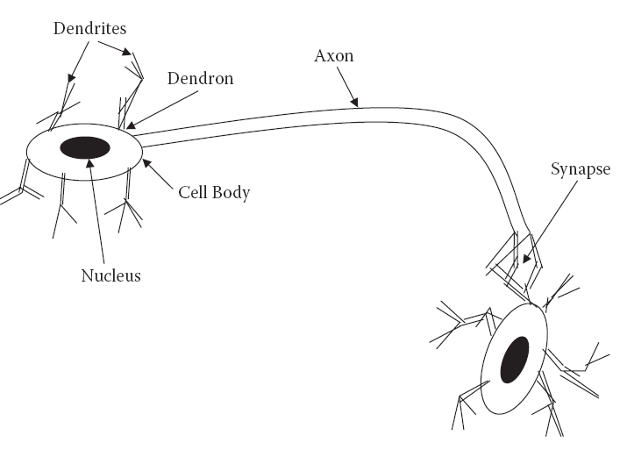
Structural Components of a Neuron
A neuron has four main structural components:
the dendrites, the cell body, the axon, and the synapse.
Figure 2.2 The biological neuron.

Slide 11
Structural Components of a Neuron
Dendrites are responsible for receiving the signals from other neurons.
These signals are passed through a small, thick fiber called a dendron.
The received signals collected at different dendrites are processed within the cell body, and the resulting signal is transferred through a long fiber called the axon.
At the other end of the axon exists an inhibiting unit called a synapse, which controls the flow of neuronal current from the originating neuron to the receiving dendrites of neighboring neurons.

Slide 12
The Artificial Neuron
The artificial neuron is the most basic computational unit of information processing in ANNs.
Each neuron taking information from a set of neurons, processing it, and giving the result to another neuron for further processing.
These neurons are a direct result of the study of the human brain and attempts to imitate the biological neuron.
“The neural network, by its simulating a biological neural network, is a novel computer architecture and a novel algorithmization architecture relative to conventional computers.
It allows using very simple computational operations (additions, multiplication, and fundamental logic elements) to solve complex, mathematically ill-defined problems, nonlinear problems, or stochastic problems” (Graupe, 2007).

Slide 13
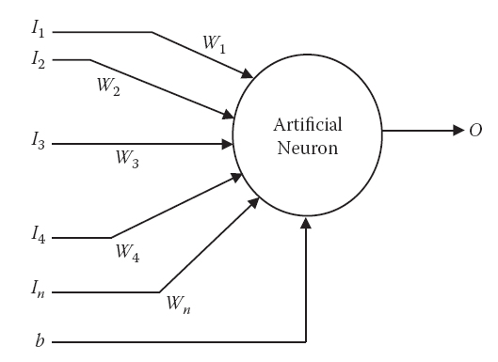
Structure of an Artificial Neuron
The neuron consists of a number of inputs. The information is given as inputs via input connections, each of which has some weight associated with it.
An additional input, known as bias, is given to the artificial neuron.
Figure 2.3 A single artificial neuron.

Slide 14
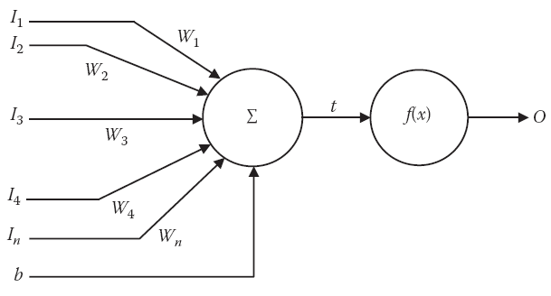
Structure of an Artificial Neuron (continued)
Figure 2.4 The processing in a single artificial neuron.
the inputs are marked I1, I2, I3, … , In; the weights associated with each
Connection are given by W1, W2, W3, … , Wn; b denotes the bias; and the output is denoted by O. Because there is one weight for every input, the number of inputs is equal to the number of weights in a neuron.

Slide 15

The Processing of the Neuron
Functionality of neuron that is performed can be broken down into two steps. The first is the weighted summation, and the second is the activation function. The two steps are applied one after the other, as shown in Figure 2.4.(in the previous slide)
The function of the summation block is given by Equation
The summation forms the input to the next block. This is the block of the activation function, where the input is made to pass through a function called the activation function.

Slide 16

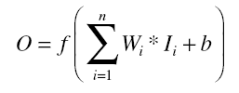
The Activation Function
The activation function performs several important tasks,
One of the more important of which is to introduce nonlinearity to the network.
Another important feature of the activation function is its ability to limit the neuron’s output.
The complete mathematical function of the artificial neuron can be given as:
where f is any activation function

Slide 17

The Perceptron
The perceptron is the most basic model of the ANN. It consists of a single neuron. The perceptron may be seen as a binary classifier that maps every input to an output that is either 0 or 1.
The perceptron is given by the function represented by Equation
where w is the vector of real-world weights, x is the input, “.” is the dot product of the two vectors, and b is the bias.
The perceptron has learning capabilities in that it can learn from the inputs to adapt itself. As a result, the perceptron is able to learn historical data.

Slide 18
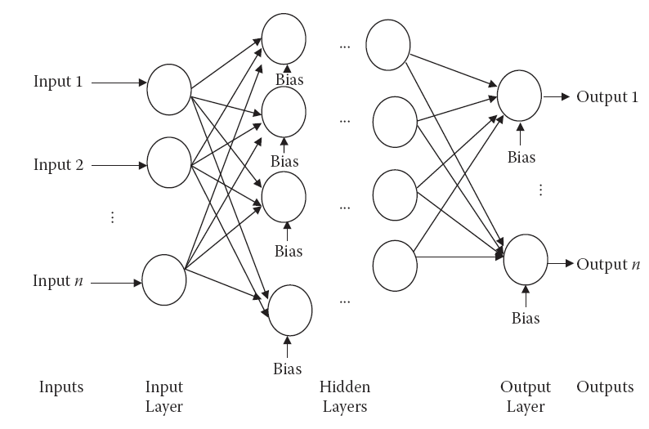
Multilayer Perceptron
Multilayer perceptrons are networks used to overcome the linear separability limitation of the perceptrons.
Figure 2.5 The general architecture of the multilayer perceptron.

Slide 19
Multilayer Perceptron
An MLP consists of
1. An input layer,
2. At least one intermediate or “hidden” layer,
3. And one output layer,
The neurons from each layer being fully connected (in some particular applications, partially connected) to the neurons from the next layer. (Kasabov, 1998)
In this section, we take you through an in-depth analysis of ANNs, including a discussion of the various concepts and building blocks of these networks.

Slide 20
Layers
The entire architecture of the ANN is in the form of layers
The number of layers decides the computational complexity of the ANN.
In generally, every ANN has at least three layers:
1.the input layer,
2.the hidden layer,
3.and the output layer.
Although there is only one input layer and one output layer, there can be multiple hidden layers.
The first layer is the input layer. The number of neurons in the input layer is equal to the number of inputs of the system. Each neuron corresponds to one input.

Slide 21
Layers (continued)
The second layer is the hidden layer. This layer does the intermediate processing.
Usually the number of neurons in this layer is larger than the number of neurons in both the input layer and the output layer.
The last layer is the output layer. In this layer, the number of neurons is equal to the number of outputs that the system is supposed to provide. Each neuron corresponds to a particular output in the system.

Slide 22
Weights
Weights corresponding to each input are multiplied by the inputs during the aggregation, or weighted addition. The only way to control the system’s output is to change the various connections.
In fact, memory in the context of ANNs is in the form of its weights.
These weights, along with the network architecture, determine the intelligence of the ANN.
Hence, whenever we talk of the ANN’s ability, we are actually referring to the weights.
The ANN of some problem can be transformed into the ANN of another problem if we copy the weights from the other ANN.

Slide 23

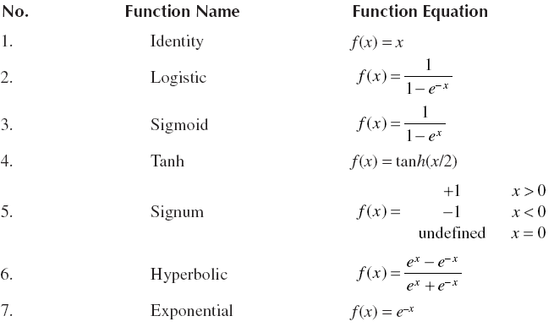
Common Activation Functions

Slide 24
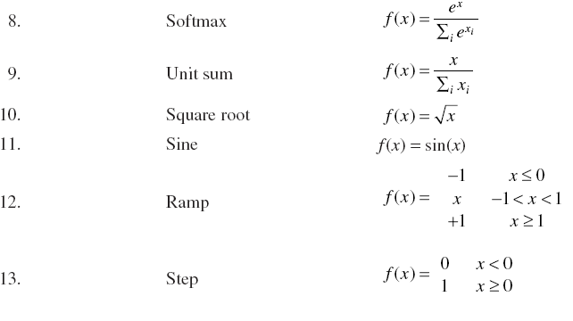
Common Activation Functions (continued)

Slide 25
Weights
Weights corresponding to each input are multiplied by the inputs during the aggregation, or weighted addition. The only way to control the system’s output is to change the various connections.
In fact, memory in the context of ANNs is in the form of its weights.
These weights, along with the network architecture, determine the intelligence of the ANN.
Hence, whenever we talk of the ANN’s ability, we are actually referring to the weights.
The ANN of some problem can be transformed into the ANN of another problem if we copy the weights from the other ANN.

Slide 26
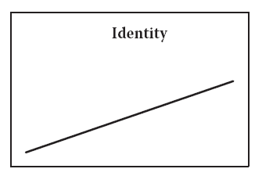
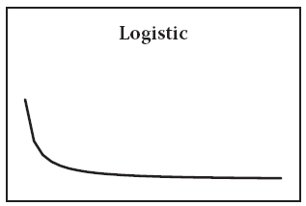
Activation functions
We talked about activation functions as a fundamental operation of the artificial neuron
The graphs of some of these functions are given in Figures.
The identity activation function.
The logistic activation function.

Slide 27
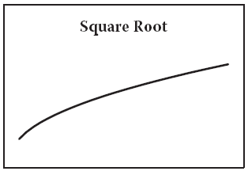
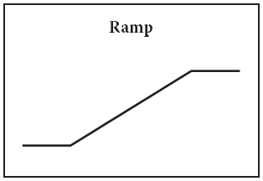
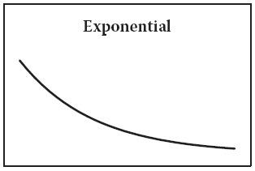
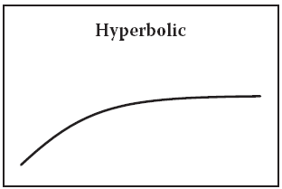
Activation functions Graphs(continued)
The square root activation function.
The ramp activation function.
The exponential activation function.
The hyperbolic activation function.

Slide 28
Feed-Forward Neural Network
In a feed-forward neural network, information flows from the inputs to the outputs, without any cycle in their structure.
These simple ANNs are easy to work with and visualize. And yet they still have great capabilities for problem solving.
The non–feed-forward neural network may have cycles in its structure.
These networks include recurrent neural networks in which time delay units are applied over the system in cycles, which causes the present outputs to be affected by previous outputs as well as new inputs.

Slide 29
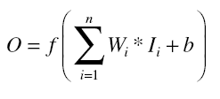

Example
Calculate the output for a neuron. The inputs are (0.10, 0.90, 0.05), and the corresponding weights are (2, 5, 2). Bias is given to be 1. The activation function is logistic. Also draw the neuron architecture.
Solution:
Using Equation, we have
where I1 = 0.1, W1 = 2, I2 = 0.9, W2 = 5, I3 = 0.05, W3 = 2, and b = 1.
Hence the neuron’s output is
  f(W1 * I1 + W2 * I2 + W3 * I3)
  = f(2 * 0.1 + 5 * 0.9 + 2 * 0.05)
  = f(0.2 + 4.5 + 0.1)
  = f(4.8)
  = 1.008

Slide 30
Functional Prediction
This type of problem usually has a continuous output for every input. In this case, the ANN is made to predict an unknown function of the form y = f(i1, i2, i3, …. , in), where i1, i2, i3, …. , in are the various inputs.
If we plot a graph between the output and the inputs, we would have a complex surface with a graph spanning across n dimensions.
let us assume that the system to be predicted is f(x, y) = sin(X2 + Y2).
If we were given some points in this graph, we have two ways to complete the curve in order to find the value of the function at unknown points. In the first approach, we try to see the training data in the vicinity of this point or input.

Slide 31
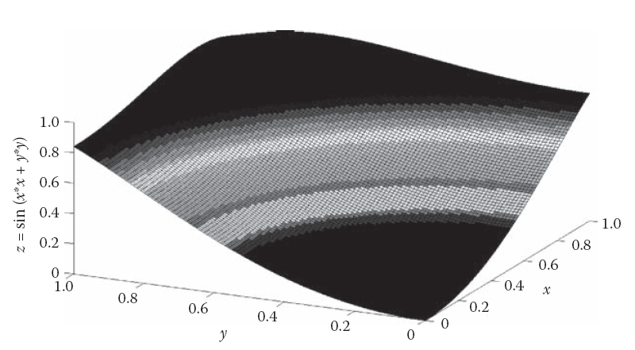
Functional Prediction
The function f(x, y) = sin(X2 + Y 2).

Slide 32
Functional Prediction
This type of problem usually has a continuous output for every input. In this case, the ANN is made to predict an unknown function of the form y = f(i1, i2, i3, …. , in), where i1, i2, i3, …. , in are the various inputs.
If we plot a graph between the output and the inputs, we would have a complex surface with a graph spanning across n dimensions.
let us assume that the system to be predicted is f(x, y) = sin(X2 + Y2).
If we were given some points in this graph, we have two ways to complete the curve in order to find the value of the function at unknown points. In the first approach, we try to see the training data in the vicinity of this point or input.

Slide 33
Functional Prediction
The other way to complete the curve is to look at all the training data sets and, based on these sets, form a global curve that gives the least error or deviation with the training data set points while also maintaining its smoothness.
Once this curve for the entire input space has been plotted, we can find the output at any point.
In this globalized approach, the output of a point depends on all the inputs in the training data sets. This technique is much more resistant to noise but is very difficult to learn.
The same happens to be true with ANNs that try to predict or construct the surface to complete the whole curve.

Slide 34
Classification
Classification is the second type of problem handled by ANNs. In these problems, the ANN must classify the inputs and map them to one of the many available classes.
The output in these problems is discrete and gives the class to which the input belongs.
An important factor in these problems is the number of classes. The more classes, the greater the complexity of the algorithm.

Slide 35
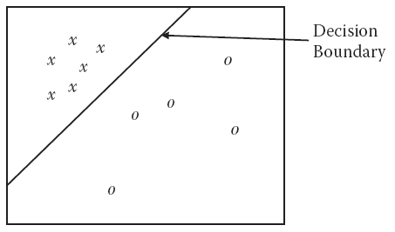
Classification
Suppose that the data we want to classify depend upon two parameters. We plot this on a two-dimensional graph, with the classes X and O marked in the graph by x and o.
In this example, the ANN is supposed to divide the entire space into two distinct regions.
The first region belongs to the class X, and the second region to the class O. The line in the figure is called the decision boundary

Slide 36
Classification
Decision Boundary draws the boundary between the different classes. The decision boundary may be in the form of a line, oval, or any other simple or complex shape.
If the decision boundary can easily be drawn in the multidimensional input space of the problem, then the problem can easily be solved by the ANN.
Decision Boundary can be most appropriately represented by the equation y = f(i1, i2, i3, …. , in), where i1, i2, i3, …. , in are the various inputs.
It is clear from our understanding of coordinate geometry that the value inside the curve would be less than 0 and that outside the curve would be greater than 0. This principle is used to find whether the points lie inside or outside the curve.

Slide 37
Normalization
It is preferred that the inputs and outputs in any system lie between a fixed and manageable upper and lower limit.
This avoids the problem of ending up with a computation above the programming tool’s limitations at any of the intermediate levels.
We therefore fix the upper bounds and the lower bounds for all the inputs to fall between some minima and maxima.
This process is done by the technique of normalization, which is a means for mapping an input with a known minimum and maximum range to a range that is desired.

Slide 38


Normalization
Suppose that any of the input attributes in the problem have a lower limit of Xmin and an upper limit of Xmax. We want to map the input within the limits of Vmin and Vmax.
The general formula for computing the corresponding output y for any input x is given by Equation
Say we want our inputs and outputs to lie between –1 and 1. Now ymin = –1 and ymax = 1, thus modifies to Equation

Slide 39


The Problem of Nonlinear Separability
An ANN must classify a set of data into two classes. We see that the separation could easily be made by a simple line.
Consider a perceptron with two inputs x and y and a bias b. The output of this model would be as given by equation:
Say, for simplicity, that the activation function is identity, as shown in Equation
Because this equation can represent any line, we can train the perceptron to solve the problem by adjusting the weights w1 and w2 and the bias b.

Slide 40
Bias
Bias is the additional input given to ANNs.
During testing, they are treated just like any other input and are modified according to the same rules as the inputs.
Bias is believed to give the system more flexibility. Biases can be used to add means of adjustment to ANNs, and hence become instrumental tools in adjusting the ANN at the time of training.
Let us take the example of a simple, one-neuron system. Say it has two inputs x and y
We can easily conclude that without bias, we cannot solve the problem

Slide 41
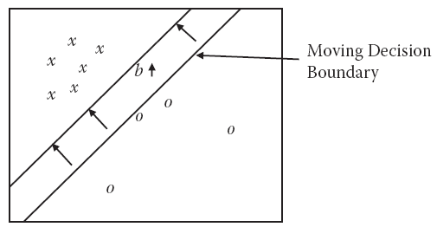
Bias
We can also see from Figure that changing the bias gives greater freedom to the decision boundary to adjust itself according to the problem’s requirements.
The bias moves the decision boundary forward (or backward) to keep the slope constant. (The effect of changing weights w1 and w2 may be visualized by the readers themselves; they would cause the slope of the line to change.)

Slide 42
Types of Data Involved
We know that ANNs need a good amount of data to train themselves. The more data, the better the system’s performance. The data in this approach are generally divided into three sets,
  • Training data : These data are used by the training algorithm to set the ANN’s parameters, weights, and biases. Training data make up the largest set of data, comprising almost 80 percent of the data.
  • Testing data: This data set is used when the final ANN is ready. Testing data, which are completely unknown, are used to test the system’s actual performance. The testing data set consists of about 10 percent of the data.
  • Validation data: These data are used for validation purposes during the training period. At any point during training, we measure the error on both the training data and the validation data. The size of this data set is about 10 percent of the entire data set.

Slide 43
Training
ANNs are able to learn the data presented in a process known as training
The training algorithm tries to adjust the various weights (and biases) and set them to a value such that the ANN performs better at the applied input.
Note that each ANN might not be able to train itself well for all architectures. This performance and training depends on the number of hidden layers as well as on the neurons in these hidden layers.
Changing the architecture cannot be performed during training.
Because this entire activity is manual, it may take a long time and a great deal of experience before a designer is able to selects a final design.

Slide 44
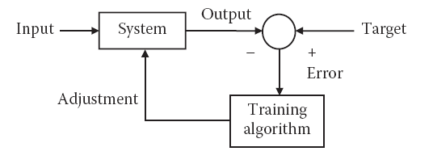
Types of Learning
When discussing ANNs, learning refers to the learning of the data presented. This learning may be broadly classified into three categories.
  • Supervised learning : In this kind of learning, both the inputs and the outputs are well determined and supplied to the training algorithm. Hence whenever an input is applied, we can calculate the error. We try to adjust the weights in such a way that this error is reduced.
Figure: The basic block diagram of supervised learning.

Slide 45
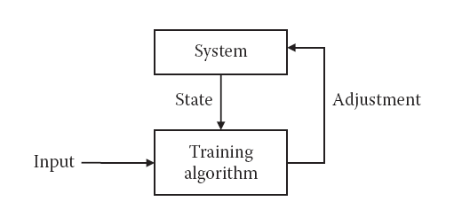
Types of Learning
• Unsupervised learning: In this type of learning, the target outputs are unknown. The inputs are applied, and the system is adjusted based on these inputs only.
Either the supporting weights of the problem are added or the dissipative nodes are decreased. In either case, the system changes according to the inputs.
The result is that the system gets ready to give the correct answer whenever the same input is applied.
Figure: The basic block diagram of unsupervised learning.

Slide 46
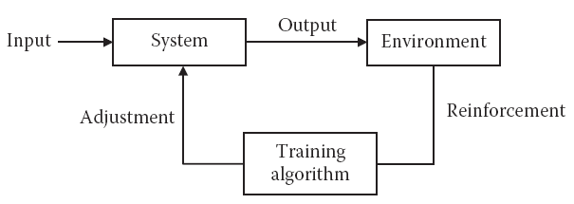
Types of Learning
• Reinforcement learning: As its name implies, this type of learning is based on the reinforcement process. In this system, the input is applied. Based on the output, the system either gives some reward to the network or punishes the network.
In this learning technique, the system tries to maximize the rewards and minimize the punishment. The basic block diagram is given
Figure: The basic block diagram of reinforcement learning.

Slide 47
The Stages of Supervised Learning
To train the ANN, we need to apply the input, get the output, and accordingly adjust the weights and biases.
ANNs are used for training as well as for testing.
Training deals with giving inputs to the network, noting its errors, and making related modifications.
This involves a forward step in which the input is applied and the output is retrieved and a backward step in which the error is calculated and the relevant changes are made.
In testing, however, there is only a forward path.

Slide 48
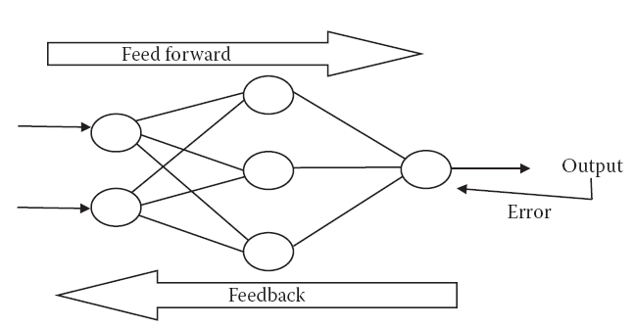
The Stages of Supervised Learning
The application of inputs and the calculation of outputs both require the flow of information from one neuron to another until the final output neuron calculates the final answer.
This step in the training process is called the feed-forward step.
Once the output to the applied input is known, the error can be calculated.
Figure: The feed forward and the feedback stages in the artificial neural network.

Slide 49
The Stages of Supervised Learning
An error in ANN is measured by using error measurement functions.
Commonly used error functions are:
• Mean absolute error
• Mean squared error
• Mean squared error with regression
• Sum squared error
An ANN’s error is a direct result of the adjustments in weights and biases carried out in the ANN.
The only way to effect the error during real-time training is to change the weights and biases.

Slide 50
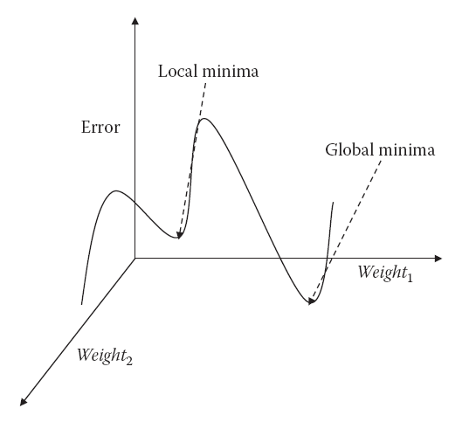
The Stages of Supervised Learning
Every combination of weights and biases has some error associated with it. This information can be plotted graphically in a multidimensional graph, where the number of dimensions is the number of weights and biases, plus 1 to represent error.
These graphs, which are known as error surface graphs or configuration graphs, represent the error for every combination of weights and biases.
Figure: The error graph.

Slide 51
Epoch
ANN training is done in a batch-processing mode, in which a batch consists of all the training data set cases.
This complete pack is presented to the system for training. After the system finishes processing all these inputs, the same batch is applied again for another iteration of updating the weights and biases.
A single iteration of applying all the inputs, or the input package, is known as the epoch.
After multiple epochs, the system is said to be fully trained. The number of epochs required for the system to train itself varies according to the problem and the training data.

Slide 52
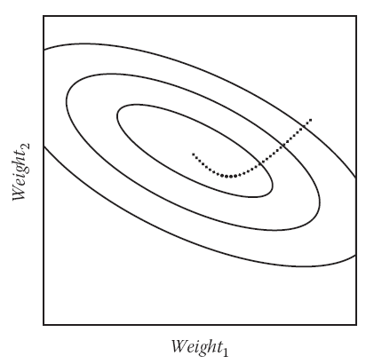
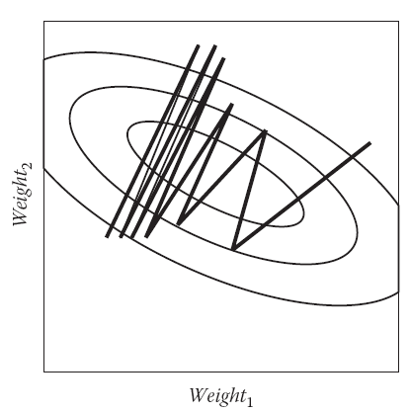
Learning Rate
The learning rate is the rate by which the system learns the data.
The learning rate is denoted by ‘η’, a fraction that measures between 0 and 1.
A contour line of a function of two variables is a curve along which the function has a constant value.
Figure: Error contours and learning at a small learning rate. at a large learning rate.

Slide 53
Variable Learning Rate
One solutions for choosing the correct learning rate is to keep the learning rate as a variable.
A variable learning rate allows a system to be more flexible.
The concept of a variable learning rate is analogous to the frame rate example we mentioned earlier.
Suppose there is an action scene in your movie. You might consider watching the scene at a lower frame rate so as to get the complete details. Or you may fast forward through most of the scenes because they do not appeal you.

Slide 54
Momentum
The training algorithm is an iterative algorithm, which means that at each step, the algorithm tries to move in such a way that the total error is reduced.
In the error graph the deeper valley corresponds to a lower error, and hence to a better configuration of the ANN, than the shallower valley.
The deeper valley is known as the global minima, which is the least error in the entire surface. The shallower valley is called the local minima.
The training algorithm is trying to move in such a way that error is reduced, it keeps following the local minima.

Slide 55
Momentum
It can easily be seen that if it continues to move in the same direction, it would eventually attain the global minima.
This problem is solved by introducing a term called momentum.
The momentum keeps pushing the training algorithm to continue moving in the previous direction, making it possible for the training algorithm to escape out of the local minima.
The meaning of momentum in this case is analogous to the meaning of momentum in the physical world.
For example, a ball moving has momentum that keeps it moving in the same direction.

Slide 56
Stopping Condition
The algorithm stops according to the stopping condition. Normally one or more of the following criteria are used as stopping conditions:
  • Time: The algorithm may be stopped when the time taken to execute exceeds more than a threshold.
  • Epoch: The algorithm has a specified maximum number of epochs. Upon exceeding this number, the algorithm may be stopped
  • Goal: The algorithm may be stopped if the error measured by the system reduces to more than a specific value. It may not be useful to continue training after this point.
  • Validating data: If the error on validation data starts increasing, even if there is a decrease in the testing data, it would be better to stop further training.
  • Gradient: Gradient refers to the improvement of the performance or the lowering of the error in between epochs.

Slide 57
Back Propagation Algorithm
One of the algorithm used to train the ANN
This algorithm, called the back propagation algorithm (BPA), is a supervised learning algorithm that calculates the error and then back propagates the error to previous layers.
These previous layers then adjust their weights and biases accordingly, and the configuration is thus changed.
The changing of the weights and biases follows the approach of steepest descents, which is explained in the next section

Slide 58
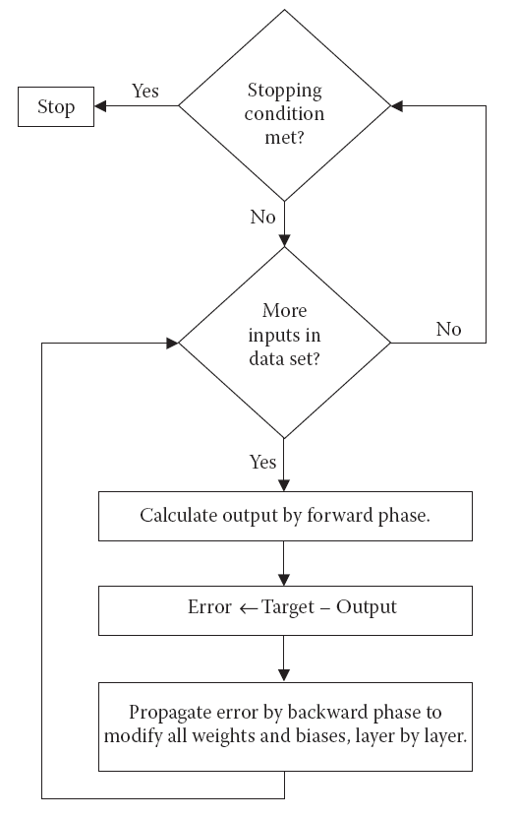
The flow diagram of the back propagation algorithm.

Slide 59
Mathematical Analysis of the BPA Expression
The first step in the BPA is the forward phase, where the output from the system is calculated.
For the output neurons, which decide the system’s final output, the error d may be calculated by the expression given in Equation
where Odesired is the desired target output and Oactual is the actual output obtained by the system.
The weight from the neuron p at layer k – 1 to neuron q at layer k is denoted by Wp,q,k

Slide 60

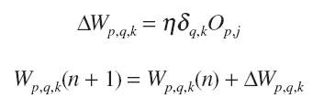

Mathematical Analysis of the BPA Expression
Expression of is
And the final weight is
where Wp,q,k(n) is the weight from neuron q at layer k to neuron p at layer k – 1 at the nth iteration,
is the error generated at neuron q in layer k, Op,j is the output of neuron p positioned at layer j, and η is the learning rate.

Slide 61
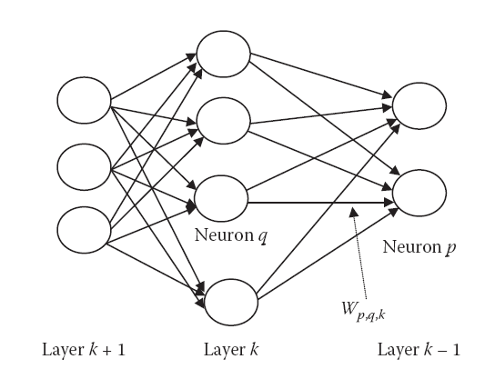
The notation of weights in ANN for the back
propagation algorithm.

Slide 62

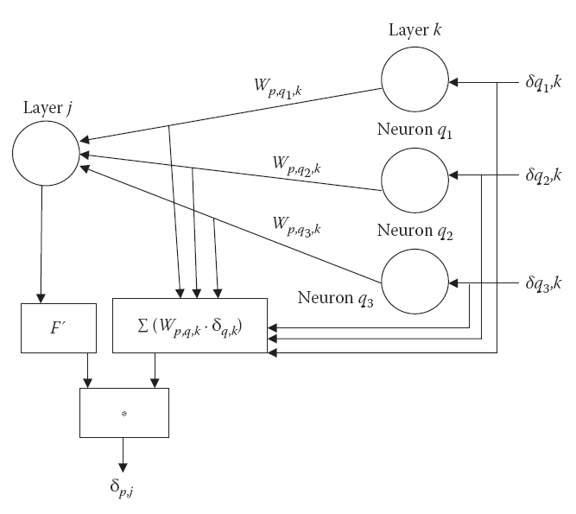

The computation of at layer j.
The error of neuron p at layer j is given by

Slide 63
Convergence
The decrease in error is more drastic at the start and less so at the later epochs.
The change in error decreases, and the error function in the later stages behaves as a constant. This is referred to as convergence.
It may however be noted that the error function will not always converge to some point.
It is also possible that the ANN may start behaving abnormally and the error may increase indefinitely.
In this case, the ANNs would not give a decent performance.

Slide 64
Generalization
Generalization is the ability of the ANN to give correct answers to unknown inputs.
Generalization is a measure of how well a system has been trained.
Generalization is measured by the performance of the system for the testing data set.
The ANN’s generalization capability should hence be as high as possible.

Slide 65
Convergence
The decrease in error is more drastic at the start and less so at the later epochs.
The change in error decreases, and the error function in the later stages behaves as a constant. This is referred to as convergence.
It may however be noted that the error function will not always converge to some point.
It is also possible that the ANN may start behaving abnormally and the error may increase indefinitely.
In this case, the ANNs would not give a decent performance.

Slide 66
Overgeneralization
In this situation, the ANN performs very well for the training data but fails to perform well for the validation data.
This problem may be caused by excessive neurons, excessive training duration, or other similar reasons.
Overgeneralization occurs when the ANN, by its training algorithm, starts imitating very complex functions in place of the simple ones.
The solution to the problem of overgeneralization is to take a separate set of data, called validation data, and stop training as soon as the error starts increasing in the validation data set,

Slide 67
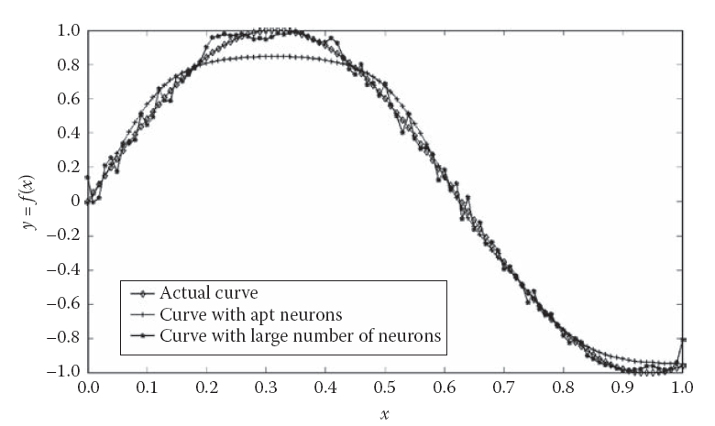
The overgeneralization problem.

Slide 68
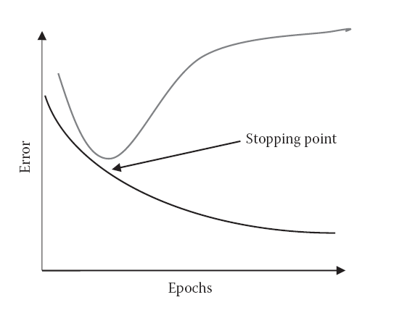
Early stopping with the help of a validation data set

Slide 69
Complexity
An increase in the number of layers of an ANN increases the complexity of the ANN by a great extent.
The same is true for the addition of neurons.
These additions also have the problems of overgeneralization, as discussed above.
Thus, it is best to have just one hidden layer. If the system does not train, however, we may have two hidden layers.
The number of neurons in any case must be the minimum that can make the ANN reach the goal.

Slide 70
Example of Time Series Forecasting
The problem is a general class of problems that try to predict the future based on past trends.
It takes as input the past values of the variable or series being monitored.
Then the ANNs are applied to predict the future value.
This problem has huge practical applications and can be applied over various domains.
It may be used to predict the number of customers at any store, the agricultural yield, or even the stock market behavior.

Slide 71
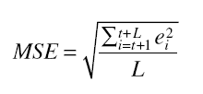
Problem Description
The time series consists of a series of observations in the form of (x1, x2, x3, x4, . . .).
The problem assumes that the future values are a function of past values.
It assumes that is possible to get the future values based on the past values as the series repeats itself.
The performance of the series is measured by the root mean square error,
Here error ei is measured as the difference between the value given by the system and the actual value at time i.

Slide 72
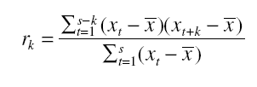
Problem Description
A very common tool for series analysis is autocorrelation, which is given by Equation
where rk is the correlation coefficient, xt is the value of the sequence at time t, x is the average value of x in the particular time frame being considered, and S is the size of the series.
Autocorrelations can be useful for decomposition of the main features of the time series, such as the trend and seasonal effects.
The seasonal effects occur in series and repeat in the time series. In the case of sales prediction, these seasonal effects include seasonal products such as air conditioners.

Slide 73
Inputs
The time series prediction problem uses the concept of a time window, which is a collection of numbers in the form <I1, I2, I3, … , Ik>, where each Ii represents the ith input to the system.
Hence there are k inputs in all. The input Ii denotes the value at a time lag of Ii units.
Thus if we are trying to calculate the output at time t, the inputs would be the value of the sequence at time t – I1, t – I2, t – I3, … , t – Ik.
One of the major problems is to decide the time window. If we increase the size of the window, the performance will increase. But this would require more training data, as well as more computational time.
On the other hand, if we make the window smaller, the performance will decrease.

Slide 74
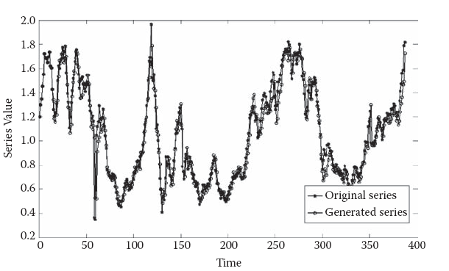
Outputs
The system’s output was the value of the series at the tth time. We repeated the experiment for all ts to predict/regenerate the complete sequence (starting from t = 15, because before that all previous inputs were unknown).
Figure: The time series forecasting experiment.

Slide 75
Network
The network was formed by trial and error. After numerous tries, we got the optimal results by the following network configuration, which we tried changing only the number of neurons in the hidden layer.
Number of hidden layers: 1
Number of neurons in hidden layer: 20
Activation functions of all neurons: Tan Sigmoid
Training method: train Gradient Descend (traingdm)
Learning rate: 0.1
Momentum: 0.01
Max epochs: 2,500
Goal: 0.01
Note that the goal was not met, even upon reaching the maximum epochs during training.

Slide 76
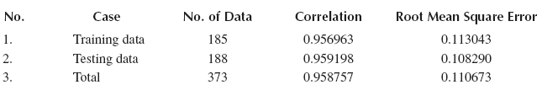
Results
The results of the algorithm are given in Figure 2.24. The blue line shows the original series.
The data on the left consist of the training cases, while the data on the right consist of the test data.
The results are further summarized in Table
In this example, we used ANN to solve a real-life problem and got good results.
Results of Time Forecasting Experiment

Slide 77
Conclusion
The ANN can be seen as an instrumental tool for solving virtually any real-life problem.
ANNs are definitely the technology of the future.
In real-life systems, however, these play a great role in making a robust system that gives a very high performance.
Designing a good ANN is more of an art than a technical concept.
Equally important is the selection of inputs and outputs.
Thus we need to think broadly about the feasibility of the selected input and output parameters before even trying to train the system.
ANNs, if used cautiously, are an excellent means for solving emerging industrial problems.

